Slide 1
European Council Conclusions March 2026
[…] The recent spikes in the prices of imported fossil fuels demonstrate that the energy transition remains the most effective strategy for achieving Europe’s strategic autonomy, strengthening resilience, structurally lowering energy prices, and delivering the clean, abundant and homegrown energy needed to power the economy of the future. Accelerating the deployment and integration of renewable and low-carbon energy sources and energy storage is essential to reduce dependence on volatile fossil fuel markets and enhance security of supply. […]
​

Slide 2
The price of EU’s fossil fuel dependence
EU still sits at the mercy of others, importing around 60% of its energy — almost all of it fossil fuels. More than 80% of gas. More than 95% of oil.
The cost of most recent examples:
2022 Russian weaponisation of fossil fuel export – „fossilflation“. Eurozone inflation hit 10,6%. Annual bill for fossil fuel imports: 604 bn euros (in 2024 - 427 bn).
2026 war in Iran – 60 days of crises added 27 bn to EU’s energy bill with no extra unit of energy.
​

Slide 3
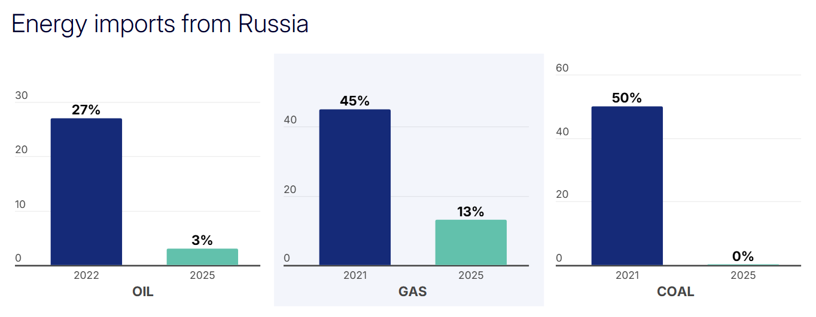
2026: better prepared than in 2022
​

Slide 4
2026: better prepared than in 2022 (2)
In 2025, renewables supplied 47.3% of EU electricity — driven by wind, and increasingly solar.
IEA estimates: the EU saved €51.4 billion in 2025 through lower fossil fuel imports.
Since war in Iran, EU solar alone has saved €110 million every single day in avoided gas.
Energy efficiency gains, from building renovations to ecodesign rules.
​

Slide 5
We are pushing fossil fuels out of electricity production
Fuel share of energy demand and of electricity generation (%)
Acceleration after last energy crisis
71%
63%
56%
47%
49%
48
30
37
Renewables
16
22
Electricity
All other fuels
Nuclear
31
28
26
25
23
2004
2010
2015
2020
2024
Source: Eurostat

Slide 6
But vulnerability remains
60% fossil fuel import dependence has not gone away.
Even without the current crisis, European companies pay 2-3 times more for energy than competitors in the US or China.
Most of the world's oil and gas reserves lie in the hands of authoritarian regimes.
The Climate and environmental risks have only deepened since 2019. Europe is the fastest-warming continent on Earth, and adapting is already estimated to cost €70 billion a year through 2050.
​

Slide 7
Green and clean economic transition: only rational way forward
Commission’s focus is to accelerate, i.a.:
Build-up of clean energy capacities
Electrification
Storage capacities
Grids and connections
Circular economy transition, incl. for critical raw materials
…
→ Green and clean transition increasingly as a matter of European competitiveness and security.
​

Slide 8
Data collection and reporting: a line of defence
Not only to see clearly, set realistic evidence-based targets, send investment where it counts, ensure accountability …
but also to maintain or earn public trust at the time of increasing climate disinformation.
The latest Eurobarometer survey on climate change shows a that a large majority of Europeans (85%) see climate change as a serious problem. 85% also believe that climate action should be a priority to improve public health, and 83% say better preparation for climate impacts will improve daily life. Honest and transparent data and reporting are key to keep it that way.
#ClimateFactsMatter
​

Slide 9


Helena Braun
European Commission Representation in Estonia
May 2026

